Slide 1
Tax Wallet
Your direct link to the IRS
Notes:
Image Source:-
https://pixabay.com/en/architecture-modern-building-facade-1048092/

Slide 2
Halcyon Practical solutions to expand your services
IRS Tax Transcripts
Close loans faster and for a fraction of the cost.
RIA Advisory Services
Provide clients full financial services with an RIA partnership.
Tax Preparation
Expand your borrower relationship with tax prep services.

Slide 3
The 4506
Limited to 120 days
Fee for every request
Inconvenient, time-consuming process
Prone to errors, requiring additional requests and fees

Slide 4
We Solve the 4506 Nuisance
Low-cost IRS Data through our API integration with the IRS
Transcripts delivered in minutes to days
Reps & Warrants from Freddie Mac (Fannie Mae on Deck)
API, Web Portal or LOS/POS Integration

Slide 5
Two Easy Paths
Replace 4506 with 8821 Form
Borrower signs 8821 consent form
Lender orders transcripts
Borrower logs in to ID.Me to approve 8821 access
Borrower has ID.Me account

Slide 6
Tax data directly from the IRS to your LOS
Both PDF and JSON format
Tax Data How You Need It!
Data can be mapped directly to your income calculator

Slide 7
More Affordable & Quicker Than IVES
IVES 4506c
HALCYON IRS VOI
Turnaround Time
Averaging 1-2 weeks
Minutes/Days
Cost
Total Cost Over $41
Per Loan App*
Multiple Borrowers
Additional Cost Per Borrower
No Additional Cost
Multiple Years (Past)
Additional Cost Per Year
No Additional Cost
Data Errors
Additional Cost
No Additional Cost
Multiple Years (Future)
No
No Additional Cost
Data for All IRS Forms
No
No Additional Cost
Digitized Data (JSON)
No
No Additional Cost
* Additional per business transcript.

Slide 8
4506 IVES
Days to Weeks
VS
Halcyon 8821
Minutes to Hours
EXAMPLE
$10 per borrower per tax year | $20
One error returned requiring re-pull | $10
Post-closing verification | $20
One cost per loan file, unlimited borrowers and tax years | $15
Less than 1% errors. No charge for re-pulls. | $0
Post-closing verification | $0
One Loan
Two Borrowers
2 Tax Years Needed
Total $50
Total $15

Slide 9
IRS & Income Tax Forms
Individual
Business
W-2
W-2G
K-1 1041
K-1 1065
K-1 1120S
1099-A
1099-B
1099-C
1099-CAP
1099-DIV
1099-G
1099-H
1099-INT
1099-K
1099-LS
1099-LTC
1099-MISC
1099-MSA
1099-OID
1099-PATR
1099-Q
1099-R
1099-S
1099-SA
1099-SB
1099-SSA
1099-NEC
1098
1098-C
1098-E
1098-Q
1098-T
1097-BTC
1042-S
3921
3922
5498
5498-ESA
5498-MSA
5498-SA
8805
1040
1040-Sch A
1040-Sch B
1040-Sch C
1040-Sch D
1040-Sch E
1040-Sch F
1040-Sch H
1040-Sch J
1040-Sch R
1040-Sch SE
1116
8995-A
1120
1120 S
1065
1120 A
1120 H
1120 L

Slide 10
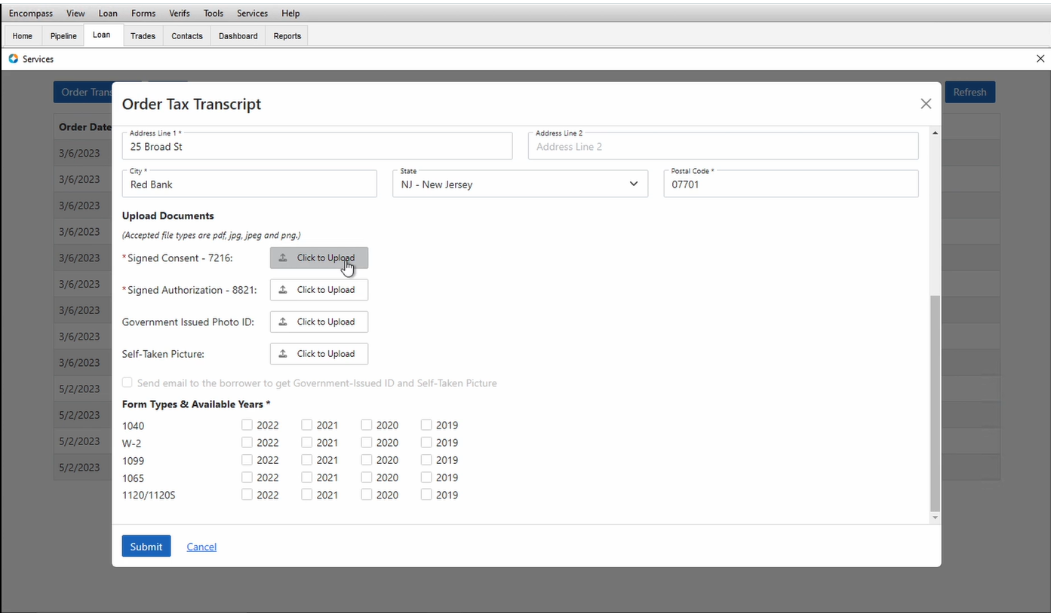
Overview…
Per loan cost model allows lenders to order what they need with no additional fees for years, borrowers, transcripts, rejects, or re-orders
Only provider with Rep & Warrant relief from Freddie Mac for income calc and data integrity
(Fannie Mae on deck for integration)
01
04
Data is delivered via PDF & JSON, without OCR, or human intervention of the data
02
05
Direct connection with IRS significantly reduces rejects and errors associated with initial requests
Offers 2 convenient order placement methods that delivers IRS responses in minutes or days based on borrower’s chosen path of comfort
Capability to pull up to 3 years in the future solving post close transcript issues and a solid Lead Generation tool
03
06
Halcyon IRS VOI’s tech stack is API driven providing quick and secure integrations with POS/LOS and 3rd party services, and can scale volume without limits, while continuing to maintain high performance and low cost.

Slide 11
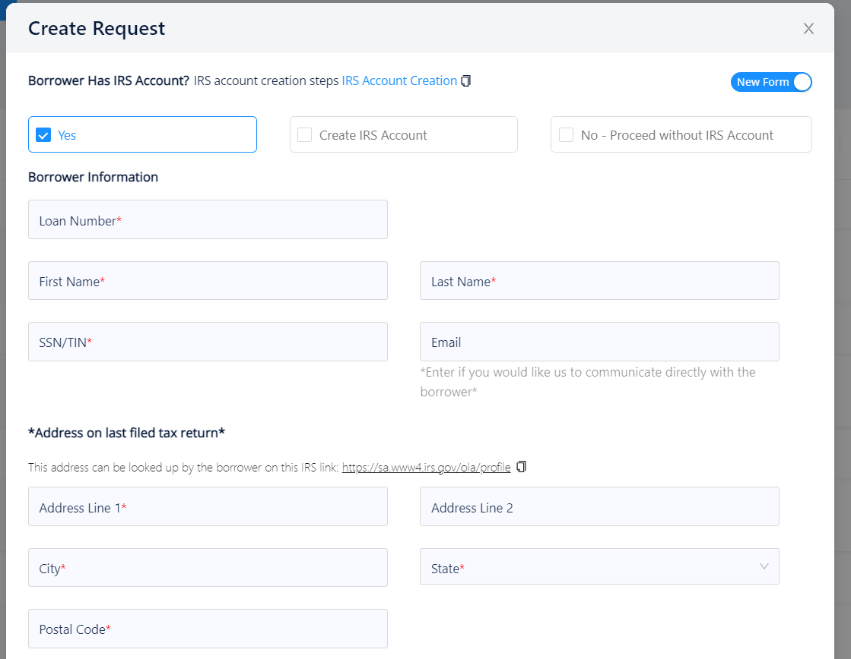
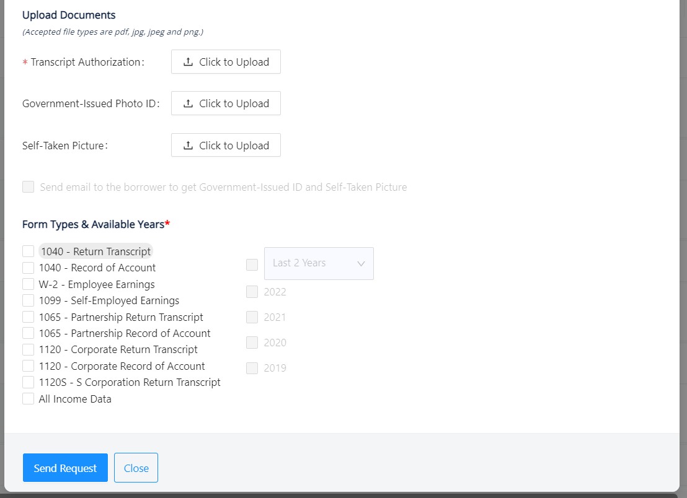
Easy Order Form

Slide 12
Freddie Mac
IRS Form 8821, 4506 or an alternate form acceptable to the IRS that collects comparable information, plus the IRS response if received. https://sf.freddiemac.com/content/_assets/resources/pdf/fact-sheet/qc_review_documentation_checklist.pdf
Fannie Mae
Form 8821 Acceptance
It is also acceptable for lenders to use either IRS Request for Copy of Tax Return (IRS Form 4506) or IRS Tax Information Authorization (IRS Form 8821). https://singlefamily.fanniemae.com/media/19711/display
HUD
For all loans processed in this manner, obtain a signed copy of IRS4506-T, Request for Copy of Tax Form, form IRS 8821,Tax Information Authorization, or a document that is appropriate for obtaining tax returns directly from the IRS. https://www.hud.gov/sites/documents/4155-1_1_SECB.PDF

